Slide 1
Lecture 8
Cryomodule Design
J. G. Weisend II

Slide 2
Goals
Define cryomodule
Describe the two principal types of cryomodules and their relative advantages
Discuss cryomodule requirements
Design considerations
Present examples of cryomodules
  TESLA
  LCLS II
  ESS
Note: some of this talk is taken from Tom Peterson’s 2019 USPAS lecture

Slide 3
Cryomodules
Cryomodules are cryostats designed to contain Superconducting Radio Frequency (SRF) cavities
  The term cryomodule was originally coined at Jlab.
SRF cavities are a very popular application of superconductivity in accelerators. There are easily more than a dozen SRF based accelerators in operation, under construction or under design worldwide. Some of these applications are very large scale.
The principles of cryomodule design are generally applicable to all cryostats.
One feature of cryomodules is that due to losses in RF superconductivity, cryomodules may have large dynamic heat loads. This feature can drive design choices.
He II (lecture 13) at ~ 2 K is the most common coolant
The design and prototyping of a new cryomodule can take a number of years.

Slide 4
Cryomodule Types
Cryomodules can be divided into two principal types:
  Separated Cryomodules
    The cryomodules in the beam line are separated from each other by room temperature sections that contain other beam line components such as magnets and beam diagnostics. The cryomodules typically have their own vacuum space and are cooled via a cryogenic distribution line that runs parallel to the beam line. In 2 K systems, the He II is created at each cryomodule. Examples include ESS, SNS, JLAB, Sprial 2, FRIB
  String Cryomodules
  The cryomodules are connected together in a long string of common vacuum and cryogenic space. There are no room temperature sections and no parallel cryogenic distribution line. The cryomodules are cooled in series and in the case of 2 K systems the He II is created at one end of the string.
  Examples include: XFEL, LCLS II, SHINE, ILC

Slide 5
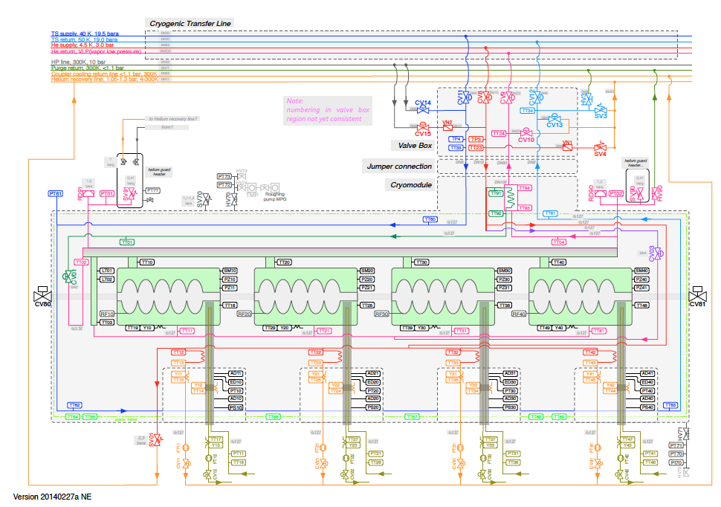
Example of a Separated
Cryomodule: ESS

Slide 6
Example of a String
Cryomodule: XFEL

Slide 7
Separated Cryomodules
Advantages:
  Flexibility and maintainability. Depending on design details, cryomodules may be repaired or replaced without warming up large sections of the accelerator.
  Separate vacuum spaces can reduce accident consequences
  Components not requiring cryogenic temperatures such as beam diagnostics can remain warm
  May be able to handle higher total heat loads
  Disadvantages:
  Higher cost
  Higher static heat loads

Slide 8
String Cryomodules
Advantages:
  Lower cost: no need for parallel transfer line and fewer valves required
  Fewer warm/cold transitions result in lower static heat loads
  Disadvantages:
  Less flexibility. Entire string may have to be warmed up to replace or repair one cryomodule
  Common vacuum space can increase consequences of accidents
  May not be able to handle high dynamic loads
  All components have to function at cryogenic temperatures

Slide 9
Cryomodule requirements
Major components
Dressed RF cavities
RF power input couplers
Intermediate temperature thermal shield or shields
Heat exchanger for 4.5 K to 2.2 K precooling of the liquid supply flow if stand-alone style
Cryogenic valves if stand-alone style
Pipe and cavity support structure
Instrumentation -- RF, pressure, temperature, etc.
Connections for helium supply and return

Slide 10
Cryomodule requirements
Major interfaces
Connections for helium supply and return
Vacuum vessel support structure
Beam tube connections at the cryomodule ends
RF waveguide to input couplers
Instrumentation connectors on the vacuum shell
Alignment fiducials on the vacuum shell with reference to cavity positions.

Slide 11
Design Considerations
Cooling arrangement for integration into cryo system
Pipe sizes for steady-state and emergency venting
Pressure stability factors
Heat load estimates and uncertainty
Options for handling 4.5 K (or perhaps 5 K - 8 K) thermal intercept flow
Alignment and support stability
Thermal contraction and fixed points with closed ends

Slide 12
Design Considerations
Support structure
  Stiffness of pipe if used as support backbone
  Or other support structure options
Emergency venting scenarios drive pipe sizes and influence segmentation
  Cold MAWP may be low, driving up pipe sizes and/or reducing spacing between relief vent ports
  Trade-off of pipe size with vent spacing
  Thermal shield pipe may also require frequent venting
    5 K may have large surface area for large heat flux
    70 K helium typically starts at a high pressure
Liquid management length
  May want to subdivide strings for liquid management due to large specific liquid flow rate per cavity

Slide 14
Example #1
TESLA Cryomodule
Developed during the 1990’s at DESY Lab (Hamburg, Germany) as the SRF solution for the proposed International Linear Collider (ILC)
  4 generations of TESLA cryomodule have been designed based on optimization and prototype results.
ILC Design Drivers
  Cost – MultiBillion $ project. Anything that can be done to reduce cost will make the project more likely
  Heat Leak - SRF cavities have dynamic heat loads but large number of cryomodules also drives the design to reduce static heat leak
  Reliability & availability – frequent repairs just aren’t an option – drives accessibility decisions plus extensive QA/QC program
  Presence of superconducting magnets (4.5 K now 2 K)
  Low pressure return line must be sized large enough so that pressure drop in vapor is small enough that the bath temperature is 2 K at the cavities furthest from the refrigerator
  Tight alignment requirements for both magnets and cavities
These requirements led to the choice of string style cryomodules.

Slide 15
Early Design Choices
Long cryogenic stretches with a minimum number of warm / cold transitions
  Reduces heat leak
  Reduces cost
No parallel transfer line to move fluids
  Cryomodules themselves are the transfer line
  Reduces heat leak and cost
Multiple thermal shields and MLI blankets
  Adds costs but reduces heat leak at low temperatures
Use He vapor line as structural backbone

Slide 16
Early Design Choices
Use welded connections whenever possible – minimize cold flange connections
  Reduces cost
  Improves reliability
Design system so that cavities & magnets can be aligned during warm assembly & maintain their alignment during cool down

Slide 17
TESLA 1st Generation
Cryomodule Design
Eight 9 cell SRF cavities + 1 s/c magnet package
Components are tied to 300 mm pipe strongback
2 thermal shields (40/80 K and 5 K)
Cold mass hangs from 3 support posts
  Cold Mass along with 2 outer posts move towards fixed center post during cool down (ends move 15 mm)
Thermal shields are made many Al pieces connected via threaded fasteners
Thermal shield pipes are SS, connected to shields via copper straps

Slide 18
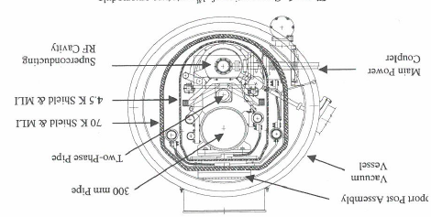
1st Generation TESLA CM
Note position of 2 phase pipe
& use of copper straps

Slide 19
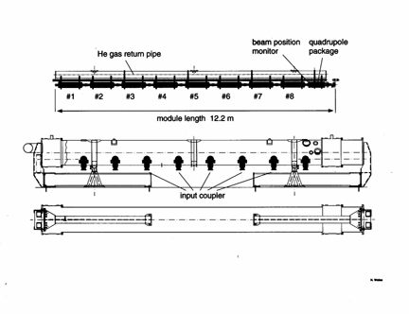
Side View of 1st Generation TESLA Cryomodule
(each end of 300 mm tube shrinks
15 mm upon cooldown)

Slide 20
TESLA Cryomodule

Slide 21
Coupler Movement
Power couplers have a fixed position to the outside world
Movement of 300 mm pipe upon cool down means you can:
  Rigidly fix cavities to 300 mm pipe and have flexible couplers OR
  Fix cavities in position with couplers and let 300 mm pipe move wrt the cavities
1st generation design used flexible coupler option

Slide 22
Changes to 2nd Generation Design
Redesign of Aluminum shields
  Larger sections welded rather than connected by fasteners – significant savings in cost & ease of assembly
  “Finger joints” for weld relief
Use Al shield cooling pipes extruded with shields and Al/SS transition joints at interconnects
  Eliminates copper straps – significant cost savings & reliability improvement
  CERN LHC approach
Rationalize tolerances for vacuum vessel
  Cost savings
  More realistic results for coupler interfaces

Slide 23
TESLA Static Heat Leak Measurements
(note total 2 K heat load is ~ 7 W)

Slide 24
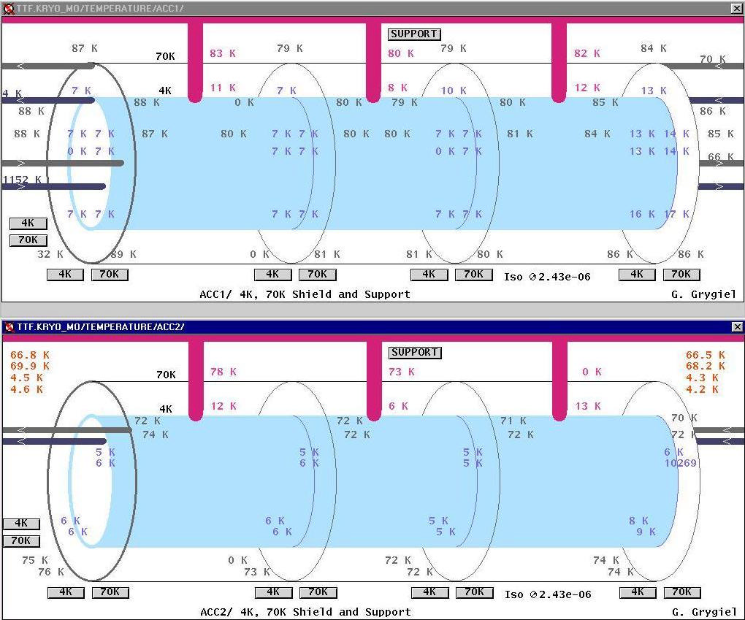
Where did the excessive static heat load from the 1st prototype CM come from?

Slide 25
Alignment Results
Cryomodule 2
Measured in Real time via Wire Position Measuring System
ILC requirements +/- 0.5 mm for cavities and +/-0.25 mm for magnet

Slide 26
Changes to 3rd Generation Design
Moved 2 Phase line & reduced vacuum vessel to a smaller standard size pipe
Relocated 3rd support post closer to s/c magnet assembly to improve stiffness
Combination of linear bearings & Invar rod decouples cavities from 300 mm tube and allows use of semi-rigid couplers
This design is the basis of the 100 Cryomodules used in the European XFEL at DESY.

Slide 27
3rd Generation TESLA Cryomodule
ILC Prototype
support
2.2 K forward
2 K return
4.5 K forward
80 K return
40 K forward
300 mm
4.5 K return
cool down/
warmup
2 K 2-phase
cavity
coupler

Slide 28
Linear Bearing Concept for Cavity Connection

Slide 29
Current ILC Design
(4th Generation)
Move magnet package to center of cryomodule
  Optimal position for maintaining magnet alignment
Operate magnet at 2 K rather than 4.5 K
  Decouples thermal shield circuit from magnet allowing shield to be optimized at 5 – 8 K.
  Reduced temperature can yield higher magnet performance & eliminates any impact due to shield circuit issues
  Requires conduction cooled HTS lead – issues with heat sinking
Will likely eliminate the 5 K shield but keep 5 K heat sink.

Slide 30
The TESLA cryomodule design is very popular
In addition to being used at the European XFEL (DESY) it is also used with some variations at other large FEL projects
SHINE (Shanghai) – Under construction
LCLS II (SLAC, USA) – Operating
NLS UK - Proposed
It is also of course the cryomodule for ILC (if built)

Slide 31
Example 2 : LCLS II
Like XFEL, a Free Electron LASER driven by an electron llinac.
But LCLS II is a continuous wave rather than pulse RF system so there is much more dynamic heat load to the 2 K space
In addition, the SLAC tunnel has a significant slope to it
These factors required changes:
  Series Parallel mode with separate He II spaces in each cryomodule
  Larger connection between Cavities and He II to stay within 1 W/m² heat transfer limit
  Removal of 5 K thermal shield

Slide 32
Cryomodules Cooled in
”Series Parallel ” mode

Slide 33
LCLS II Cryomodule: an adaptation of the XFEL design

Slide 34
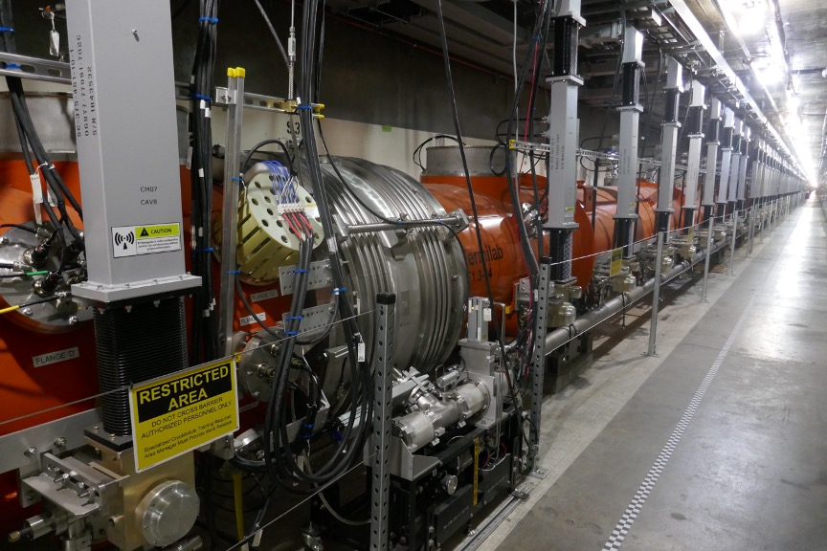
LCLS II Cryomodules

Slide 35
Example 3
ESS Elliptical Cavity
Cryomodule
The European Spallation Source (ESS) is a neutron source that use a high energy Proton linac to produce neutrons via spallation
Similar though much brighter than the SNS (USA) with a much higher energy linac (2 GeV and 5 MW)
Only 43 cryomodules required so cost and heat leak per cryomodule less of an issue than ILC or even XFEL
However the goal for availability of ESS is 95% thus reliability and maintainability are very important. This leads to:
  Having as many systems at room temperature as possible
  Having the ability to repair or replace cryomodules without warming up the entire linac
This leads us to separated cryomodules with a parallel transfer line

Slide 36
The ESS Linac
Cryogenic System
Cryogenic System of the Optimus Linac
Linac
Cryoplant
Cryogenic
Transfer
Line (75 m)
Cryogenic Distribution Line (310 m)
comprising 43 valve boxes
Auxiliary process lines
Endbox
Splitting
box
21 High Beta
Cryomodules
(174 m)
9 Medium Beta
Cryomodules
(75 m)
13 Spoke
Cryomodules
(54 m)
Superconducting section of the Optimus Linac (303 m)

Slide 37
Connection between Elliptical Cavity CM and Cryogenic Distribution Line
1) He II produced at each CM
2) Design allows independent warmup and cooldown of each CM
3) Access ports allow some in situ repair

Slide 38


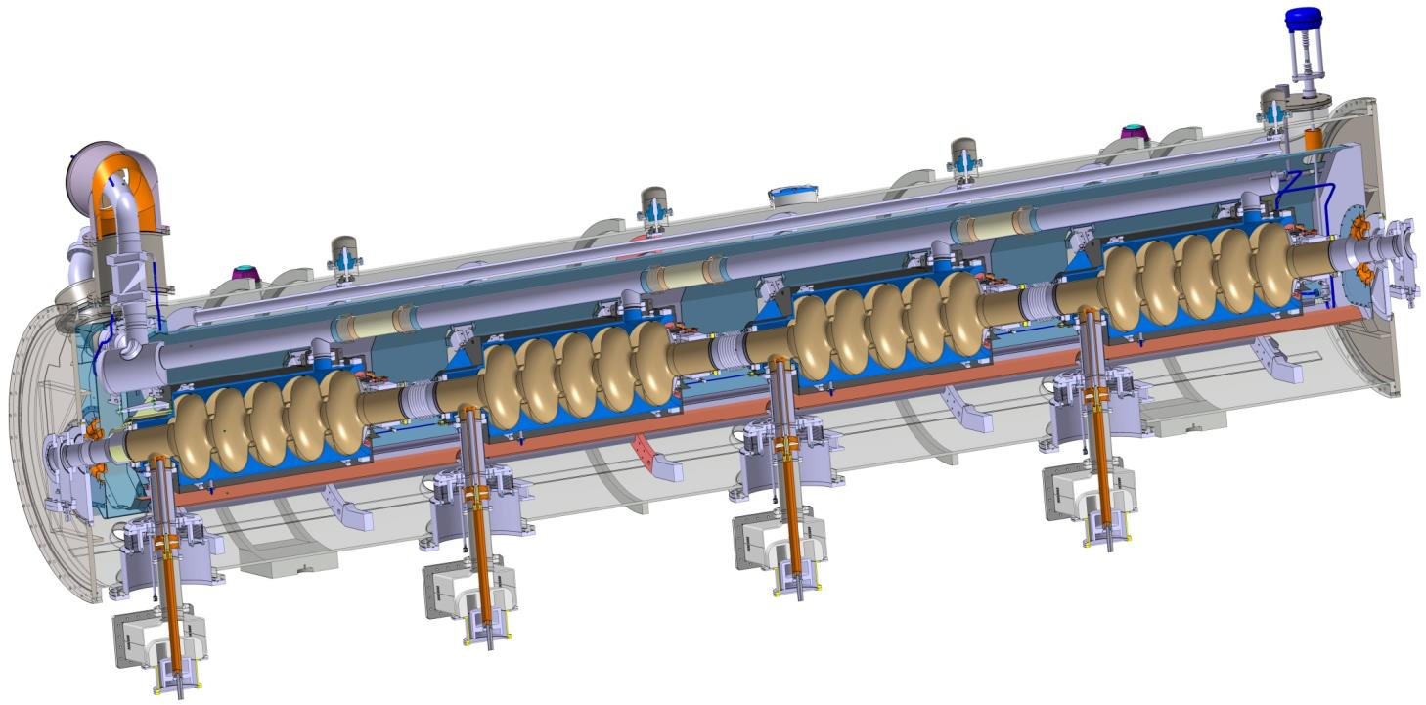
Elliptical Cavity Cryomodules
Similar to CEBAF/SNS cryomodule concept with 4 cavities per cryomodule
Common design for medium (6 cells) and high beta (5 cells) cavities
Regulation He valve
Thermal shielding
Alignement fiducial
Vacuum valve
Jumper connection
Magnetic shielding
Spaceframe support
Heat exchanger
Diphasic He pipe
Proton Beam
Cavity with Helium tank
Intercavities belows
Power coupler
Cold to warm transition

Slide 39
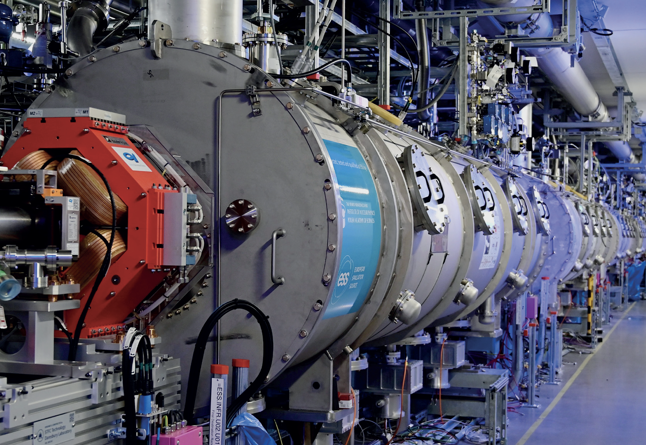
ESS Cryomodules in the Tunnel
Image courtesy of U. Hammarlund (ESS)

